Slide 1

Lesson 3: SOLUTIONS OF RIGHT TRIANGLES
Math 12
Plane and Spherical Trigonometry
Notes:
Week 2

Slide 2
OBJECTIVES
At the end of the lesson the students are expected to:
Solve right triangles
Solve real-world problems using trigonometry

Slide 3
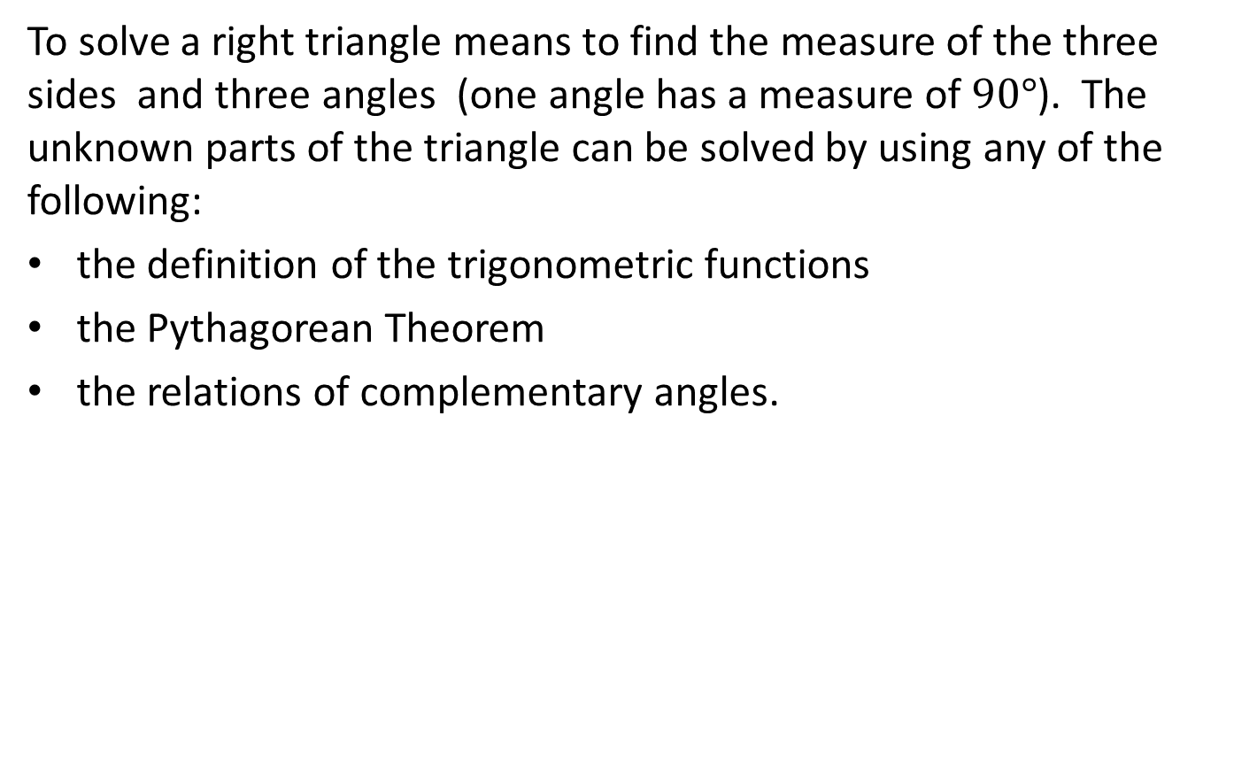
SOLUTION OF RIGHT TRIANGLE
To solve a right triangle means to find the measure of the three sides and three angles (one angle has a measure of $90°$). The unknown parts of the triangle can be solved by using any of the following:
the definition of the trigonometric functions
the Pythagorean Theorem
the relations of complementary angles.

Slide 4
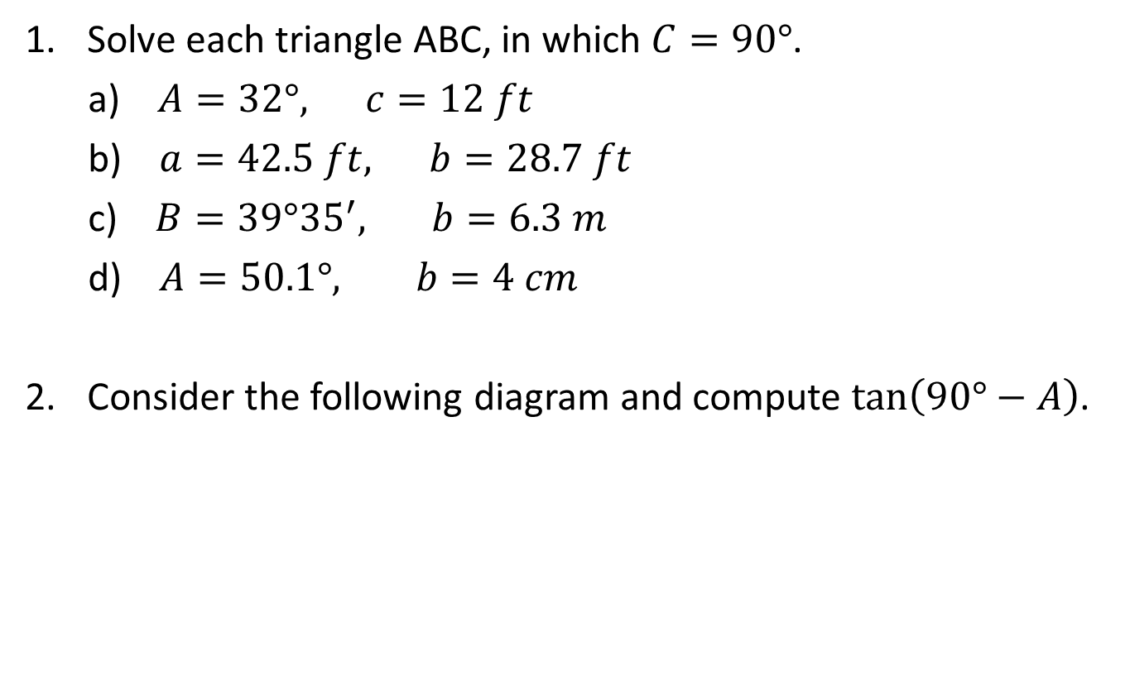
EXAMPLES
Solve each triangle ABC, in which $C=90°$.
a) $A=32°, c=12 ft$
b) $a=42.5 ft, b=28.7 ft$
c) $B=39°{35}^{′}, b=6.3 m$
d) $A=50.1°, b=4 cm$
Consider the following diagram and compute $\tan\left(90°−A\right)$.
7
2
A

Slide 5
EXAMPLES
Consider the following diagram. Determine x and y.
y
4
2A
1
x
A
3x

Slide 6
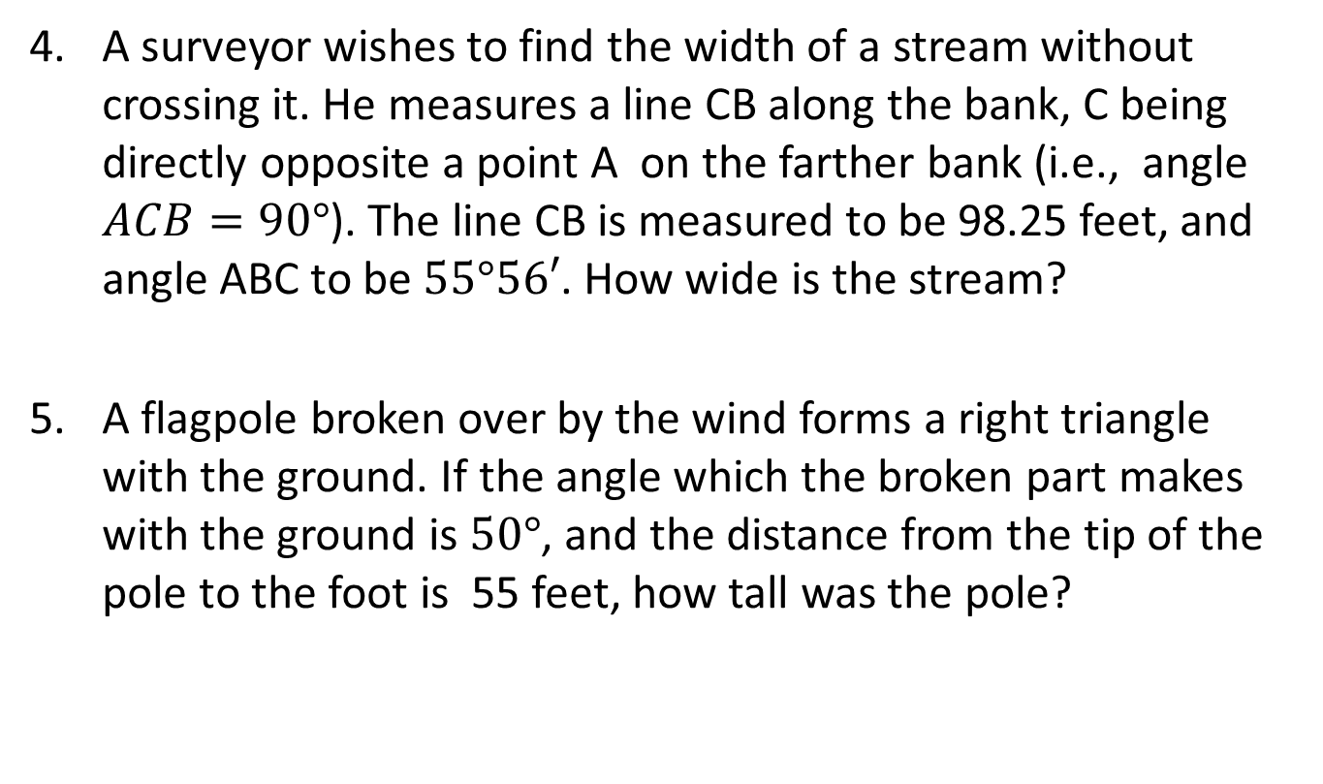
EXAMPLES
A surveyor wishes to find the width of a stream without crossing it. He measures a line CB along the bank, C being directly opposite a point A on the farther bank (i.e., angle $ACB=90°$). The line CB is measured to be 98.25 feet, and angle ABC to be $55°56′$. How wide is the stream?
A flagpole broken over by the wind forms a right triangle with the ground. If the angle which the broken part makes with the ground is $50°$, and the distance from the tip of the pole to the foot is 55 feet, how tall was the pole?

Slide 7
ANGLE of ELEVATION and ANGLE of DEPRESSION
The angle of elevation of an object which is above the eye of an observer is the angle which the line of sight to the object makes with the horizontal. If the object is below the eye of the observer, the angle which the line of sight makes with the horizontal is the angle of depression of the object.
Object
Line of sight
Angle of Elevation
Observer
Horizontal
Angle of Depression
Line of sight
Object

Slide 8
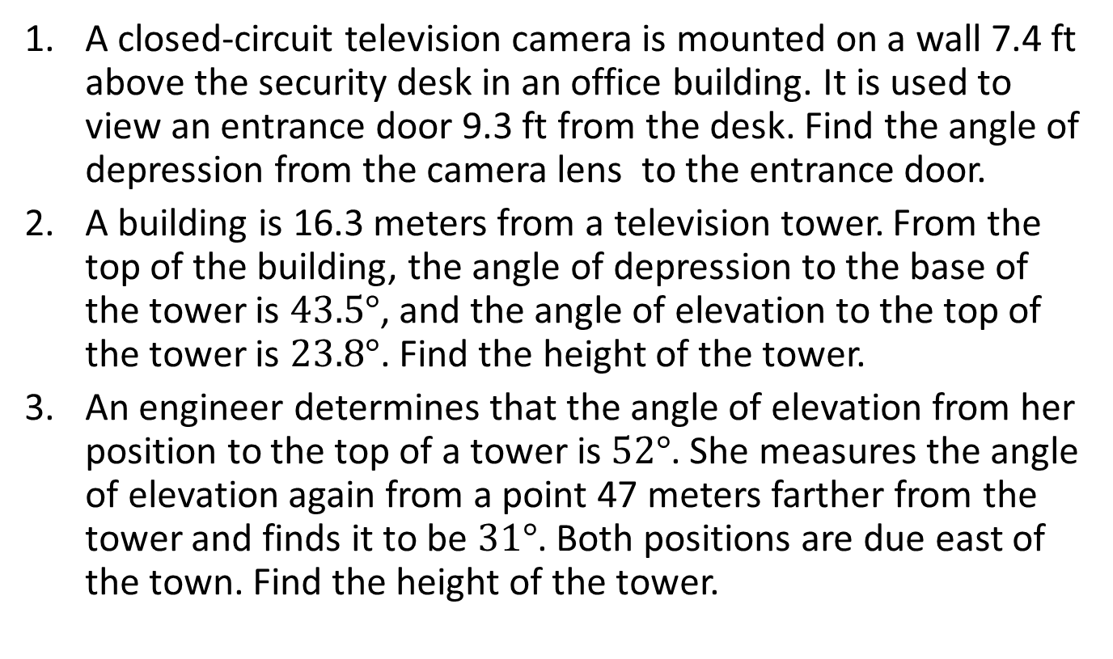
EXAMPLES
A closed-circuit television camera is mounted on a wall 7.4 ft above the security desk in an office building. It is used to view an entrance door 9.3 ft from the desk. Find the angle of depression from the camera lens to the entrance door.
A building is 16.3 meters from a television tower. From the top of the building, the angle of depression to the base of the tower is $43.5°$, and the angle of elevation to the top of the tower is $23.8°$. Find the height of the tower.
An engineer determines that the angle of elevation from her position to the top of a tower is $52°$. She measures the angle of elevation again from a point 47 meters farther from the tower and finds it to be $31°$. Both positions are due east of the town. Find the height of the tower.

Slide 9
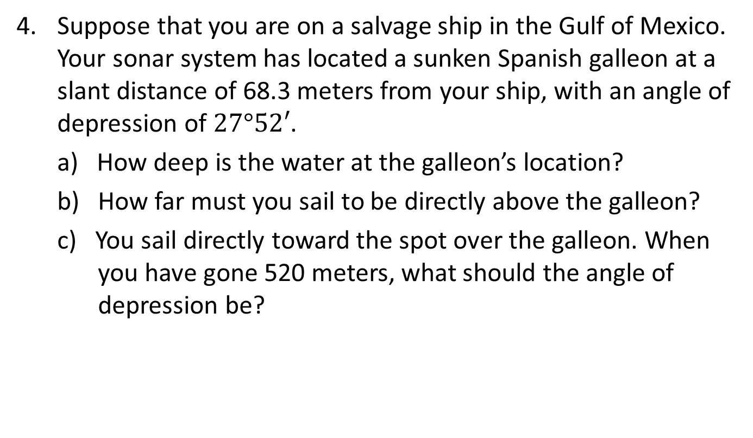
EXAMPLES
Suppose that you are on a salvage ship in the Gulf of Mexico. Your sonar system has located a sunken Spanish galleon at a slant distance of 68.3 meters from your ship, with an angle of depression of $27°52′$.
a) How deep is the water at the galleon’s location?
b) How far must you sail to be directly above the galleon?
c) You sail directly toward the spot over the galleon. When you have gone 520 meters, what should the angle of depression be?

Slide 10
BEARING and COURSE
In navigation, bearing means the direction a vessel is pointed, which is the measure of an acute angle with respect to the north-south vertical line. Course (heading) is the direction the vessel is actually traveling. It is the angle measured clockwise from the north direction to the line of travel.
Course (heading) and bearing are only synonyms when there is no wind on land.
Direction is often given as a bearing.

Slide 11
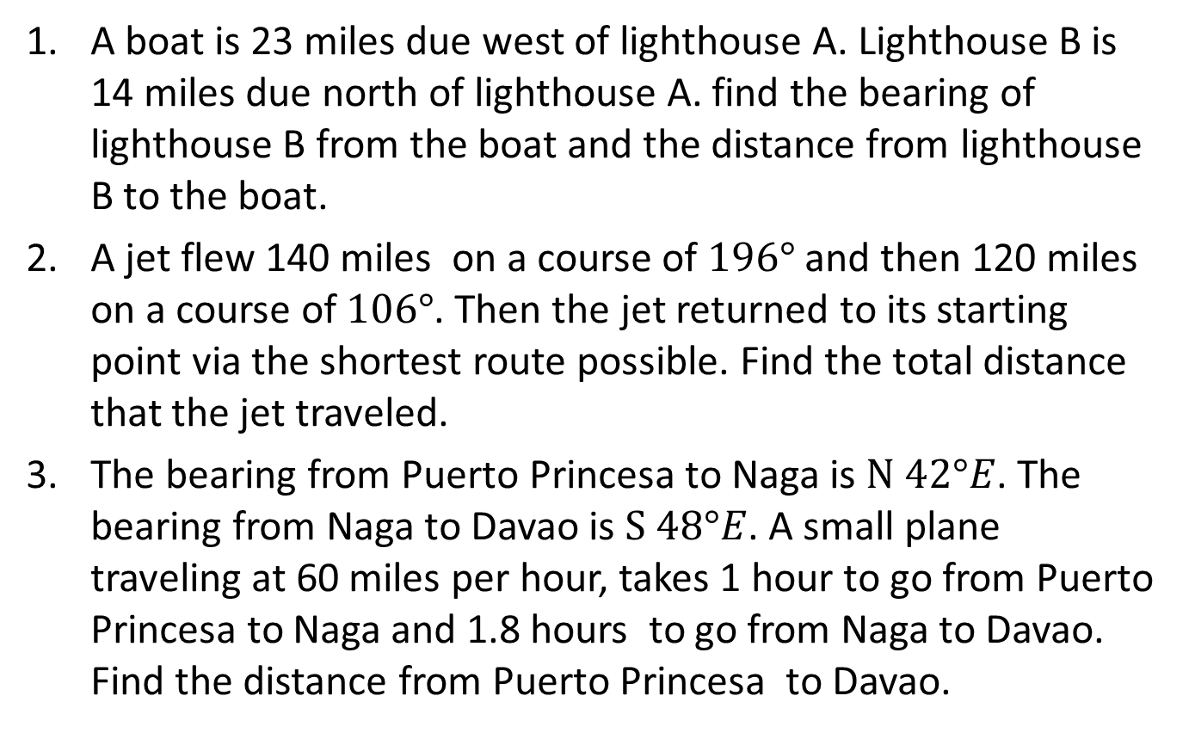
EXAMPLES
A boat is 23 miles due west of lighthouse A. Lighthouse B is 14 miles due north of lighthouse A. find the bearing of lighthouse B from the boat and the distance from lighthouse B to the boat.
A jet flew 140 miles on a course of $196°$ and then 120 miles on a course of $106°$. Then the jet returned to its starting point via the shortest route possible. Find the total distance that the jet traveled.
The bearing from Puerto Princesa to Naga is $N 42°E$. The bearing from Naga to Davao is $S 48°E$. A small plane traveling at 60 miles per hour, takes 1 hour to go from Puerto Princesa to Naga and 1.8 hours to go from Naga to Davao. Find the distance from Puerto Princesa to Davao.

Slide 12
References
Algebra and Trigonometry by Cynthia Young
Trigonometry by Jerome Hayden and Bettye Hall
Trigonometry by Academe/Scott, Foresman
Plane and Spherical Trigonometry by Paul Rider

